Slide 1


DEPARTMENT OF COMPUTER SCIENCE AND ENGINEERING
20CS7503 & DESIGN PROJECT – III
END SEMESTER PRACTICAL EXAMINATION- NOV / DEC 2025
REVIEW PRESENTATION
Batch No.:15
Date:1.12.2025
Session:AN

Slide 2
Multilingual Voice Message Translation
Guide Name:
MR.A.VIVEKIGNATIUS,M.E
Team Members:
AVINASH A 811722104019
HARI PRASATH R 811722104045
MOHAMED HARISH AH 811722104034

Slide 3
OBJECTIVE OF THE PROJECT
To translate the text into another language chosen by the user.
To convert the translated text back into clear, natural speech using a voice generator.
To help To change a spoken message into text using an automatic speech-to-text tool.
people communicate easily across different languages without needing manual translation.
To make the whole process simple through an easy-to-use interface for recording, uploading, and getting translated audio.

Slide 4
INTRODUCTION
People speak many different languages, so communicating with each other is often difficult.
Voice translation tools today are limited, because most only translate text or give basic voice output.
This project provides a complete voice-to-voice translation system, where a user speaks in one language and gets the output in another language.
The system uses AI tools like Whisper for speech-to-text, Google Translate for translation, and Microsoft TTS for natural voice output.
The goal is to make communication easier in real-life situations like education, travel, healthcare, and customer service.

Slide 5
LITERATURE SURVEY
TITLE OF PAPER | AUTHOR(S) | PAPER GIST | TECHNOLOGY USED
KIT’s Multilingual Speech Translation System for IWSLT. | Danni Liu, Thai Binh Nguyen, Sai Koneru. | 2023, Image Processing, Deep Learning | Automatic Speech Recognition (ASR), Neural Machine Translation (NMT), Text-to-Speech (TTS).
Textless Speech-to-Speech Translation on Real Data. | Ann Lee, Hongyu Gong | 2022,without relying on intermediate text,self-supervised learning. | 2Google Speech API, IBM Watson, Recurrent Neural Networks (RNN), Cloud Translation APIs
End-to-End Simultaneous Speech Translation. | Xingshan Zeng, Pengfei Li, Liangyou Li | 2022,Pretraining and knowledge distillation, incorporating automatic speech recognition. | Convolutional Neural Networks (CNN), Long Short-Term Memory (LSTM), Data Augmentation Techniques
Towards a Deep Understanding of Multilingual End-to-End Speech Translation | Haoran Sun, Xiaohu Zhao | 2023,SVCCA to analyze how multilingual speech translation models. | Tacotron, WaveNet, Neural Vocoders, Multilingual Text Processing

Slide 6
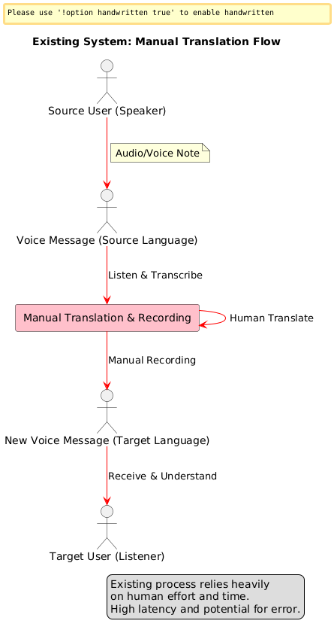
EXISTING SYSTEM ARCHITECTURE

Slide 7
PROBLEM IDENTIFICAITON
People face difficulty communicating across different languages, especially when voice messages are involved.
Existing translation tools are not complete, because they usually handle only text or give basic voice output.
Most systems are not fully integrated, so speech-to-text, translation, and speech output happen separately, causing errors and inconvenience.
Many tools struggle with accuracy, especially for regional languages, mixed languages, or low-quality audio.
There is a need for a simple, unified system that can understand speech, translate it correctly, and speak it back naturally in another language.

Slide 8
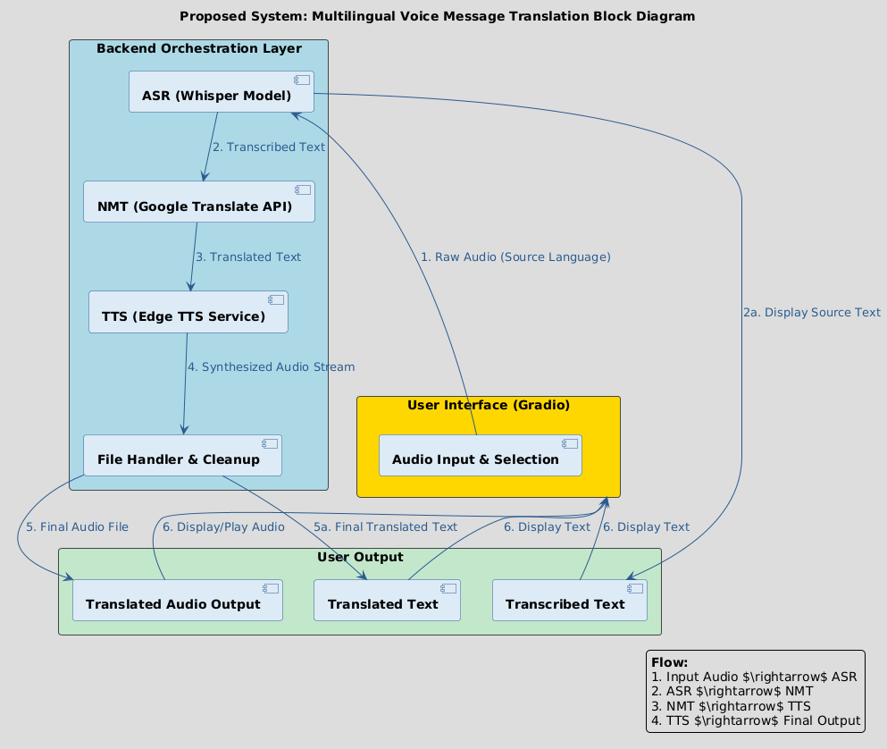
PROPOSED SYSTEM ARCHITECTURE

Slide 9
SOFTWARE AND HARDWARE REQUIREMENTS
HARDWARE
Processor: Intel i3 or above
RAM: Minimum 4 GB
Hard Disk: 256 GB or above
Microphone and Speaker: For audio input and output
System Type: 64-bit Operating System
Internet Connectivity: Required for translation API access
SOFTWARE
.Operating System: Windows / Linux
Programming Language: Python
Framework: Gradio (for User Interface)
Libraries Used:
  OpenAI Whisper (for Speech-to-Text)
  Deep Translator (for Translation)
  Edge-TTS (for Text-to-Speech)
Tools Used: Visual Studio Code / Jupyter Notebook
API: Google Translator API

Slide 10
MODULES
1.Voice Input Module
2.Transcription Module
3.Translation Module
4.Text-to-Speech (TTS) Module
5.User Interface Module

Slide 11
IMPLEMENTATION OF MODULE-1
Voice Input Module:
Enable the system to accept audio input in real-time or from an uploaded file.
Supported Languages: Tamil, Hindi, Malayalam, Kannada, Arabic, French, English.
How it Works:
The input audio is passed to OpenAI’s Whisper model.
Whisper automatically detects the spoken language.
It then transcribes the voice message into accurate text.

Slide 12
IMPLEMENTATION OF MODULE-2
2.Transcription Module:
Convert the spoken words in the uploaded voice into text.
Tool Used: OpenAI’s Whisper Model.
Key Features:
Supports automatic language detection.
High accuracy even in noisy environments or with accents.
Process:
Preprocesses the audio for noise and duration.
Runs model inference to generate textual output.
Benefits: Lays the groundwork for accurate translation by ensuring a clean and correctly interpreted transcription.

Slide 13
IMPLEMENTATION OF MODULE-3
3. Translation Module:
Translate the transcribed text into the desired output language selected by the user.
Tool Used: Deep Translator library (Google Translate API).
Process:
Detects source language automatically (in case Whisper’s language detection fails).
Uses neural network-based translation models for fluency and contextual understanding.
Supported Language Combinations: Translates between all majorworld languages.
Real-World Benefit: Breaks language barriers by allowing users to
communicate across cultures seamlessly.

Slide 14
IMPLEMENTATION OF MODULE-4
4. Text-to-Speech (TTS) Module:
To convert the translated text into a realistic male voice in the target language.
How it Works:
Translated text is sent to the TTS engine.
Voice is generated using selected neural voice
(e.g., en-US-GuyNeural, ta-IN-ValluvarNeural).
Output is saved as a .mp3 audio file for playback or download.
Technology Used: Microsoft Edge TTS (Neural voices via edge-tts library).
Advantage: Natural, expressive voice output with male voice preference.

Slide 15
IMPLEMENTATION OF MODULE-5
5. User Interface (UI) Module:
Act as the interactive front-end for users to control and use the system.
Tool Used: Gradio (Python UI Framework)
Features:
Upload audio or record directly.
Choose source and target languages from dropdowns.
View transcribed and translated text.
Play and download translated audio.

Slide 16
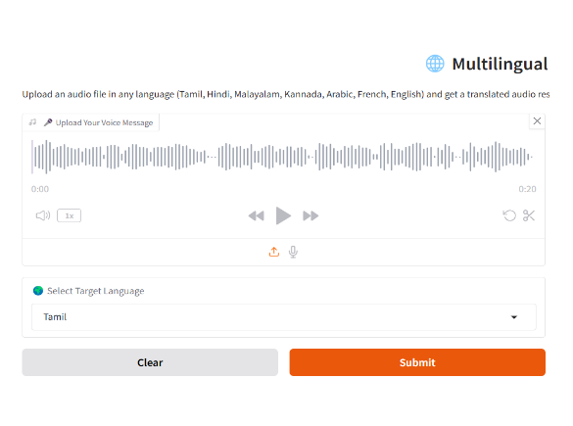

Slide 17
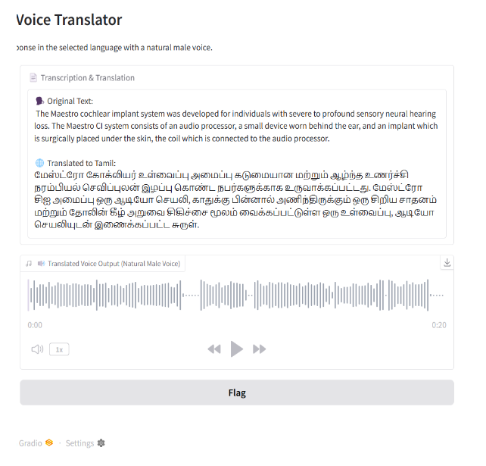

Slide 18
CONCLUSION
The Multilingual Voice Message Translation System enables seamless
communication across different languages,combining speech-to-text, translation,
and text-to-speech technologies. It has practical applications in tourism,
education, customer service, and healthcare, providing an accessible and
user-friendly solution to break language barriers.

Slide 19
FUTURE ENHANCEMENTS
Enable complete offline translation for better accessibility without internet.
Add multi-voice and emotion-based speech output for natural communication.
Implement real-time two-way conversational translation for instant multilingual interaction.
Create a mobile app version, making the tool easier to use anywhere and anytime.
Improve speech accuracy, even in noisy environments or when users speak with different accents.

